Slide 1

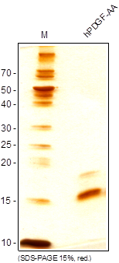
ReliaTech GmbH
Recombinant human PDGF-AA
(Cat #200-051 / 200-052
Fig. 1: SDS-PAGE analysis of recombinant human PDGF-AA produced in E. coli. Sample was loaded in 15% SDS-polyacrylamide gel under reducing conditions and stained with Silver stain.
http://www.reliatech.de / info@reliatech.de

